Slide 1
Voice Mail System
Presented By:
Md. Tanvir rahman
ID: 151-35-881
Object Oriented Software Development

Slide 2
Scenario
In a voice mail system, a person dials an extension number and, provided the other party does not pick up the phone, leaves a message. The other party can later retrieve the messages, keep them, or delete them. Real-World systems have a multitude of fancy features: Message can be forwarded to one or more mailboxes; distribution lists can be defined, retained, and edited; and authorized persons can send broadcast messages to all users.

Slide 3
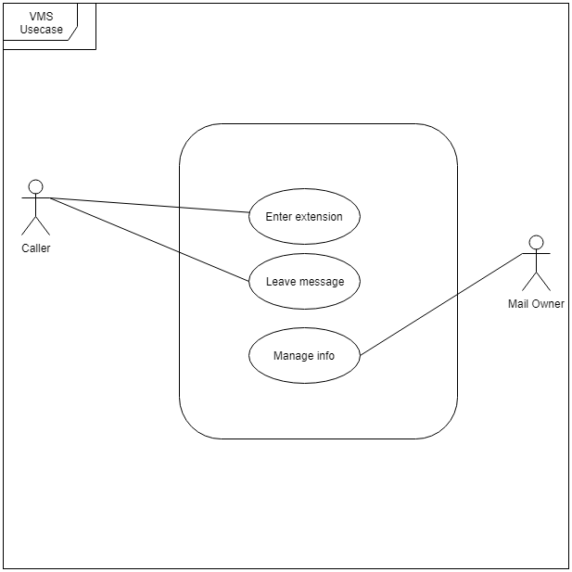
Use Case

Slide 4
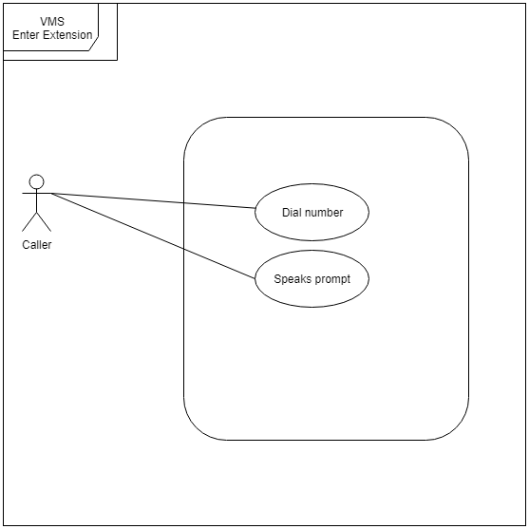
Enter Extension Use Case

Slide 5
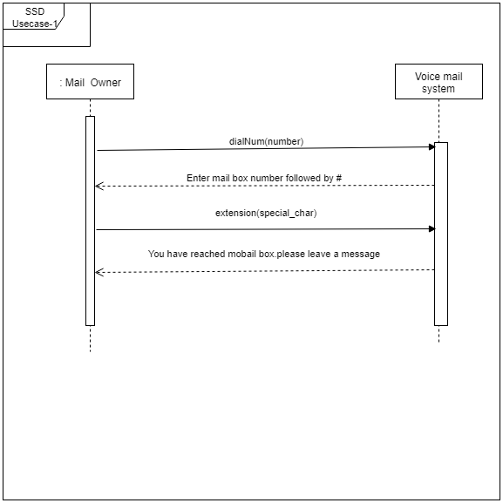
Enter Extension (SSD)

Slide 6
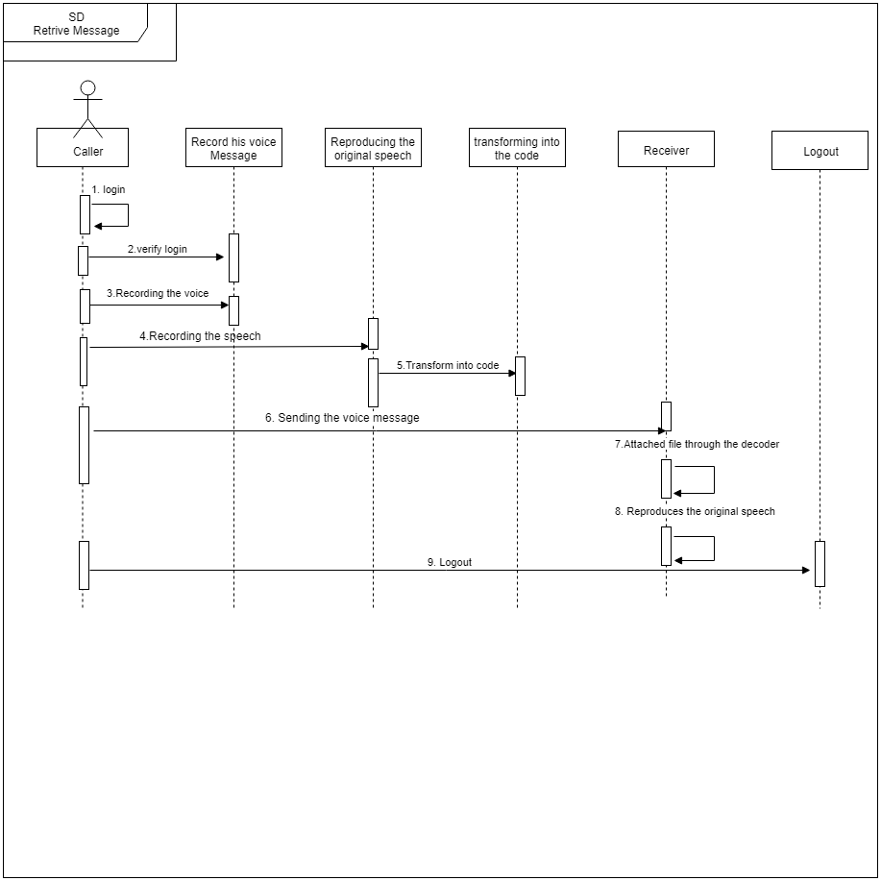
Enter Extension(SD)

Slide 7
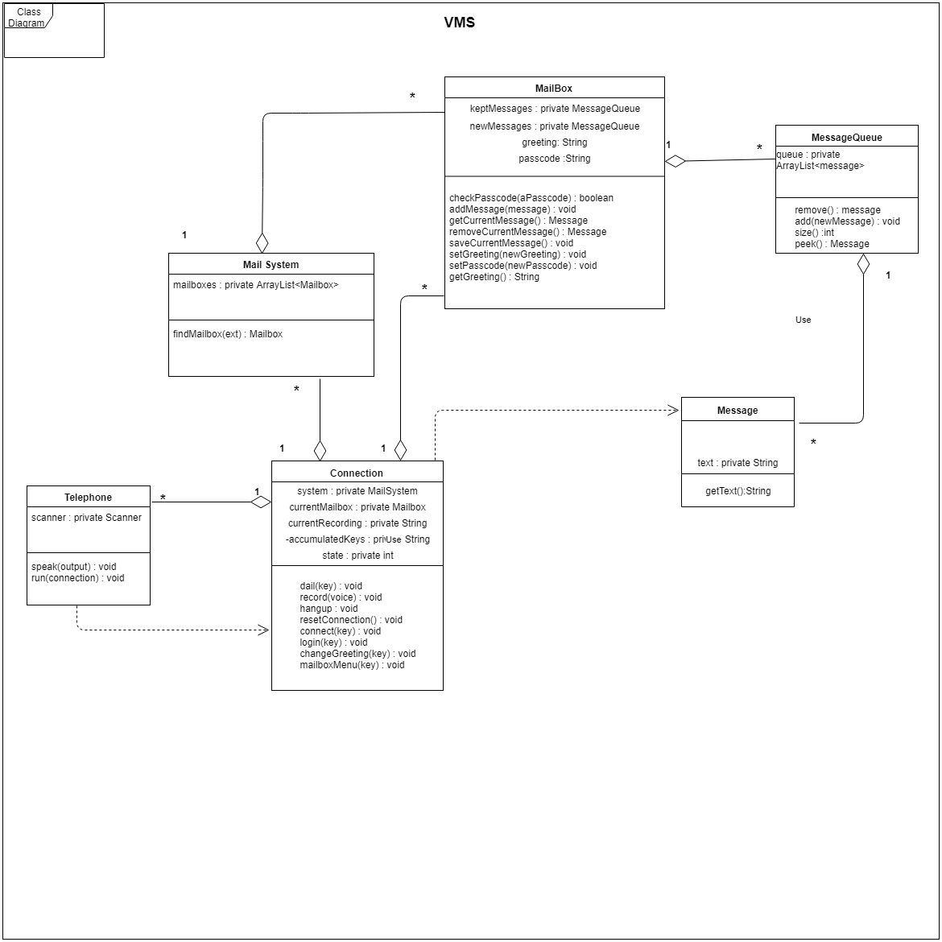
Class Diagram

Slide 8
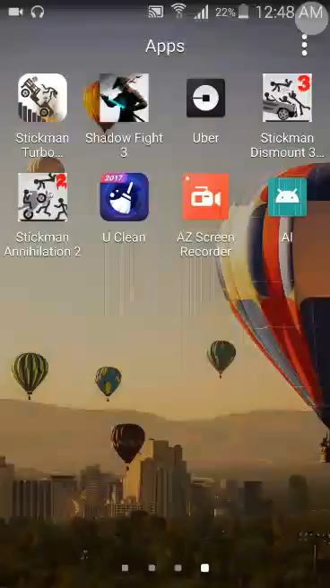

Slide 9
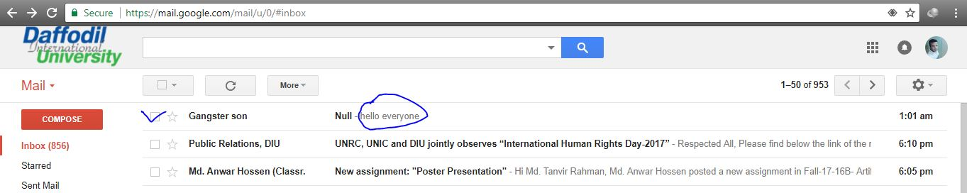
Receive Mail (output)

